Slide 1
Web hosting

Slide 2
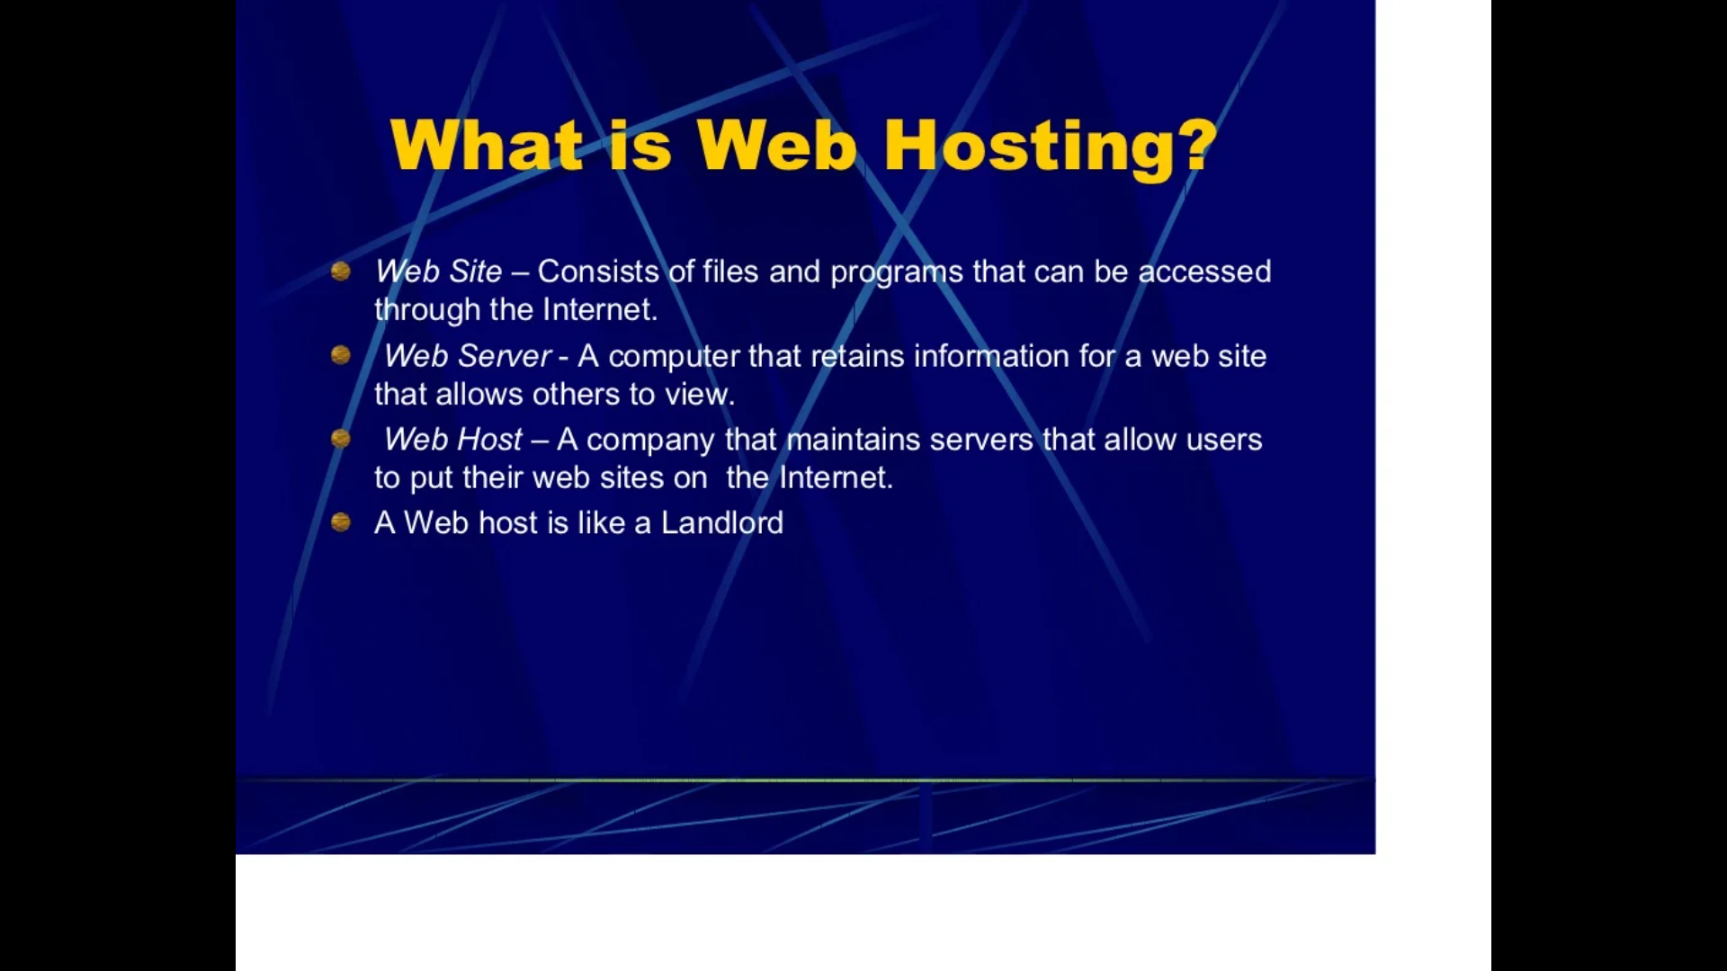

Slide 3
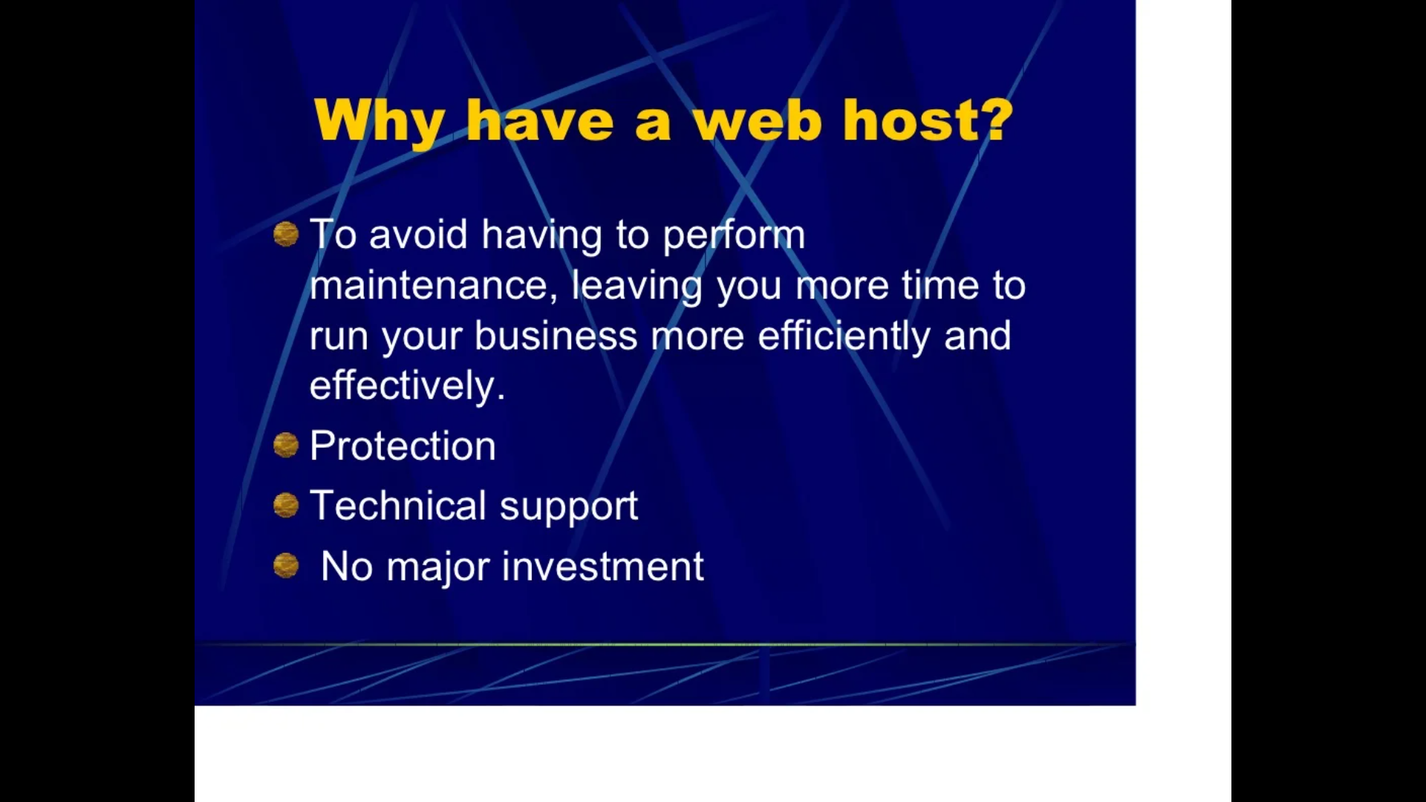

Slide 4
